Slide 1

CS 584 Machine Learning
Week 15
April 24, 2019

Slide 2

Week 15 Agenda
Ensemble Model for Improving Goodness-of-Fit
Gradient Boosting Machine (GBM)
XGBoost
Model Stacking

Slide 3
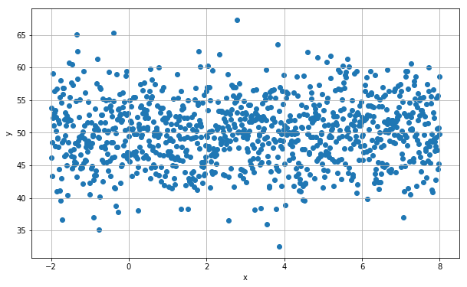
What is the Regression Line of Y on X?
Mean of:
X = 3
Y = 50.0161
Week 15 Gradient Boosting Regression Example.py

Slide 4
What is the Regression Line of Y on X?
An Unintentional Mistake:
You asked a new intern to work on this problem, and then give you the regression line and save the residuals on a file.
Since the intern saw no visual relationship between Y and X, the intern decided to build a regression line with only the Intercept term. In other words, the regression coefficient of X is fixed at zero.
After calculating the residuals, the intern saved the residuals and the predictor X on a file. Unintentionally, the intern forgot to copy the original target variable Y to the file.

Slide 5
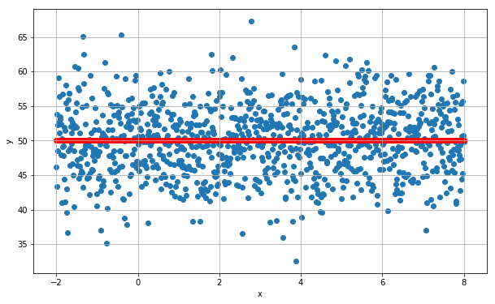
The Intercept-Only Regression
Regression Line:
Y = 50.01613046
R² = 0.0

Slide 6
What is the Regression Line of Y on X?
An Impossible Mission?
However, you do believe that there is a weak relationship between X and Y. Therefore, you want to recover the original regression line.
How can you build the original regression line without the original target variable Y?
The solution is to build a regression line of the residuals on X.

Slide 7

Residuals from the Intercept-Only Regression
Mean of:
X = 3
Residual = 0
Except for the mean of the residual, these observations look exactly like the original data

Slide 8
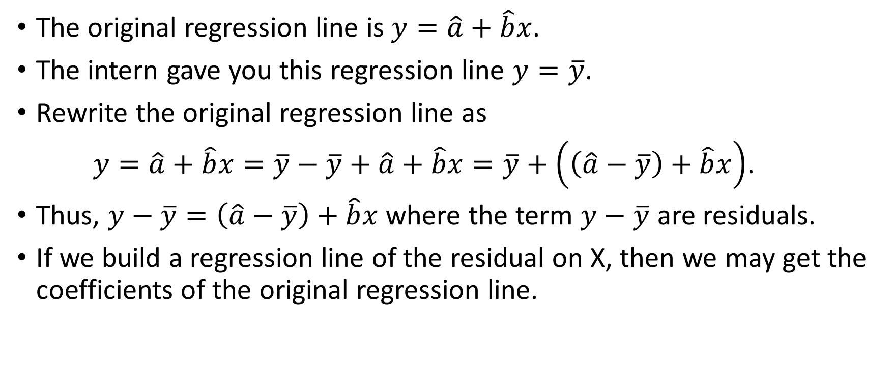
What is the Regression Line of Y on X?
The original regression line is $y=\hat{a}+\hat{b}x$.
The intern gave you this regression line $y=\overline{y}$.
Rewrite the original regression line as
$y=\hat{a}+\hat{b}x=\overline{y}−\overline{y}+\hat{a}+\hat{b}x=\overline{y}+\left(\left(\hat{a}−\overline{y}\right)+\hat{b}x\right)$.
Thus, $y−\overline{y}=\left(\hat{a}−\overline{y}\right)+\hat{b}x$ where the term $y−\overline{y}$ are residuals.
If we build a regression line of the residual on X, then we may get the coefficients of the original regression line.

Slide 9
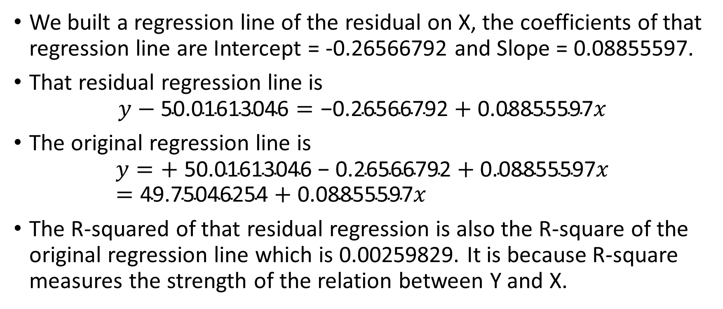
What is the Regression Line of Y on X?
We built a regression line of the residual on X, the coefficients of that regression line are Intercept = -0.26566792 and Slope = 0.08855597.
That residual regression line is
$$y−\text{50.01613046}=\text{−0.26566792}+\text{0.08855597}x$$
The original regression line is
$$y=\text{+ }\text{50.01613046}\text{ − }\text{0.26566792}+\text{0.08855597}x=\text{49.75046254}+\text{0.08855597}x$$
The R-squared of that residual regression is also the R-square of the original regression line which is 0.00259829. It is because R-square measures the strength of the relation between Y and X.

Slide 10
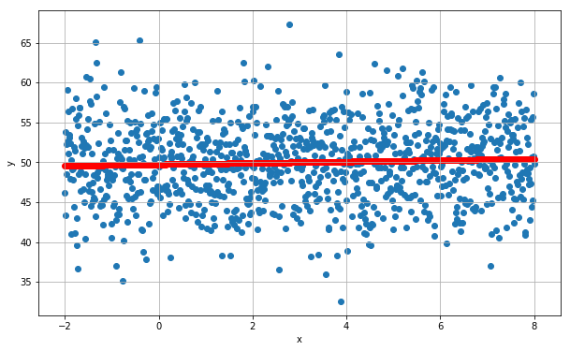
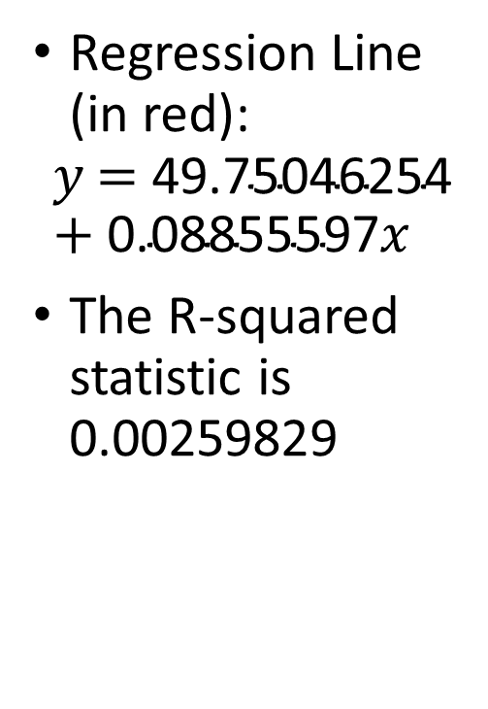
The Regression Line of Y on X
Regression Line (in red):
$$y\text{ = }\text{49.75046254}+\text{0.08855597}x$$
The R-squared statistic is 0.00259829
Week 15 Gradient Boosting Regression Example.py

Slide 11
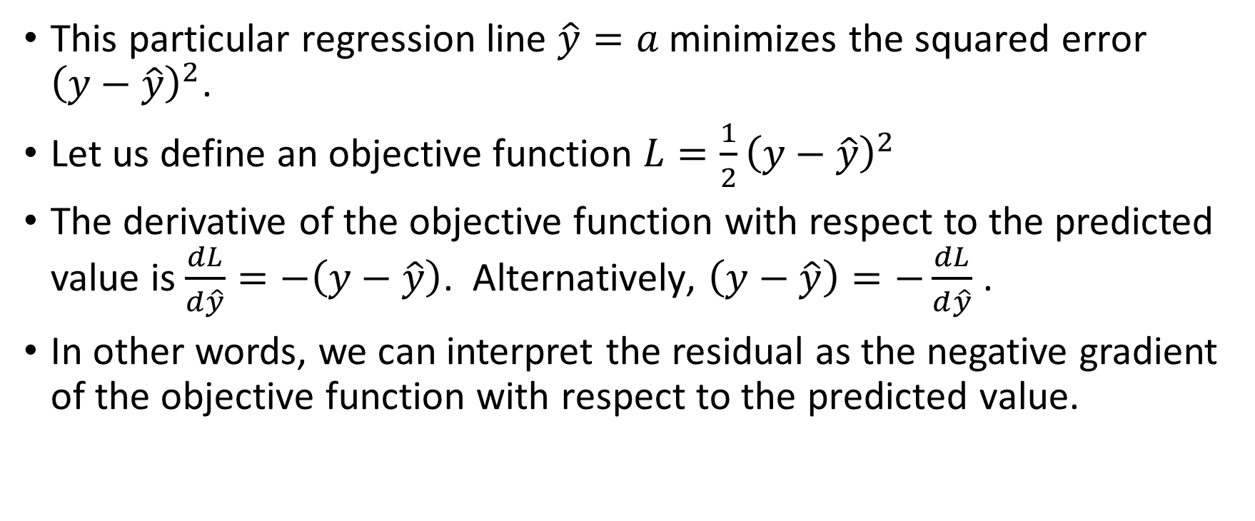
What are the Residuals?
This particular regression line $\hat{y}=a$ minimizes the squared error ${\left(y−\hat{y}\right)}^{2}$.
Let us define an objective function ${L=\frac{1}{2}\left(y−\hat{y}\right)}^{2}$
The derivative of the objective function with respect to the predicted value is $\frac{dL}{d\hat{y}}=−\left(y−\hat{y}\right)$. Alternatively, $\left(y−\hat{y}\right)=−\frac{dL}{d\hat{y}}$ .
In other words, we can interpret the residual as the negative gradient of the objective function with respect to the predicted value.

Slide 12
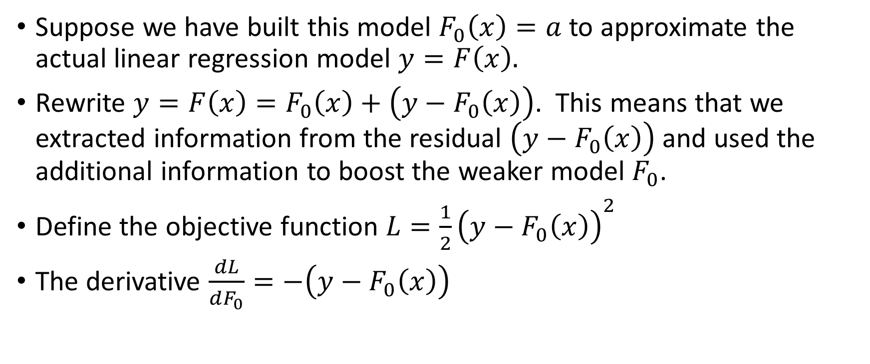
The Motivation of Gradient Boosting
Suppose we have built this model $F_{0}\left(x\right)=a$ to approximate the actual linear regression model $y=F\left(x\right).$
Rewrite $y=F\left(x\right)=F_{0}\left(x\right)+\left(y−F_{0}\left(x\right)\right)$. This means that we extracted information from the residual $\left(y−F_{0}\left(x\right)\right)$ and used the additional information to boost the weaker model $F_{0}$.
Define the objective function ${L=\frac{1}{2}\left(y−F_{0}\left(x\right)\right)}^{2}$
The derivative $\frac{dL}{dF_{0}}=−\left(y−F_{0}\left(x\right)\right)$

Slide 13

The Motivation of Gradient Boosting
Using the relation between the residual and the gradient, we have $y=F\left(x\right)=F_{0}\left(x\right)+\left(y−F_{0}\left(x\right)\right)=F_{0}\left(x\right)−1×\frac{dL}{dF_{0}}$.
This equation above looks like the gradient descent formula. Here we have Gradient Boosting.

Slide 14
History of Boosting Algorithms
AdaBoost. Yoav Freund and Robert E. Schapire (1997). A decision-theoretic generalization of on-line learning and an application to boosting. Journal of Computer and System Sciences, 55(1): 119-139.
A preliminary version appeared in the Proceedings of the Second European Conference on Computational Learning Theory, 1995. pages 23-37
Yoav Freund (1961 -), Professor of Computer Science and Engineering, University of California San Diego.
Robert E. Schapire (1963 - ), Principal Researcher, Microsoft Research in New York City.
Formulate AdaBoost as gradient descent with a special loss function. Leo Breiman (1998). Arcing Classifiers. The Annals of Statistics, 26(3): 801-849.
Leo Breiman (1928 – 2005), Professor Emeritus of Statistics at the University of California, Berkeley.

Slide 15
History of Boosting Algorithms
Generalize AdaBoost to Gradient Boosting with a general loss function. Jerome H. Friedman (2001). Greedy Function Approximation: A Gradient Boosting Machine. The Annals of Statistics, 29(5): 1189-1232.
Jerome H. Friedman (1939 - ), Professor Emeritus of Statistics, Stanford University.

Slide 16
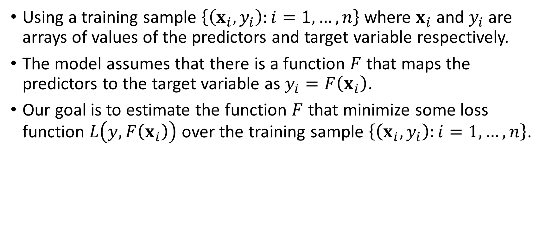
Gradient Boosting (Friedman, 2001)
Using a training sample $\left\{\left(x_{i},y_{i}\right):i=1,…,n\right\}$ where $x_{i}$ and $y_{i}$are arrays of values of the predictors and target variable respectively.
The model assumes that there is a function $F$ that maps the predictors to the target variable as $y_{i}=F\left(x_{i}\right)$.
Our goal is to estimate the function $F$ that minimize some loss function $L\left(y,F\left(x_{i}\right)\right)$ over the training sample $\left\{\left(x_{i},y_{i}\right):i=1,…,n\right\}$.

Slide 17
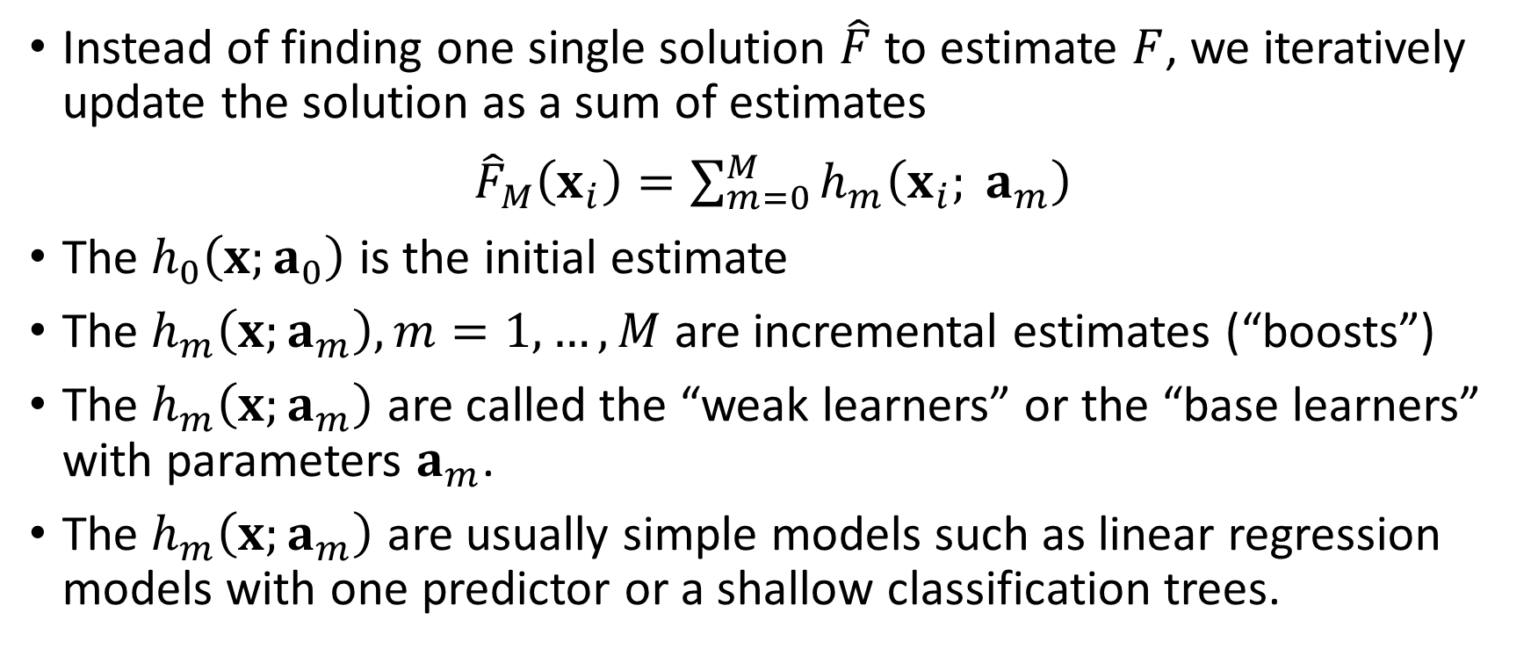
Gradient Boosting (Friedman, 2001)
Instead of finding one single solution $\hat{F}$ to estimate $F$, we iteratively update the solution as a sum of estimates
${\hat{F}}_{M}\left(x_{i}\right)=\sum_{m=0}^{M}{h_{m}\left(x_{i}; a_{m}\right)}$
The $h_{0}\left(x;a_{0}\right)$ is the initial estimate
The $h_{m}\left(x;a_{m}\right),m=1,…,M$ are incremental estimates (“boosts”)
The $h_{m}\left(x;a_{m}\right)$ are called the “weak learners” or the “base learners” with parameters $a_{m}$.
The $h_{m}\left(x;a_{m}\right)$ are usually simple models such as linear regression models with one predictor or a shallow classification trees.

Slide 18
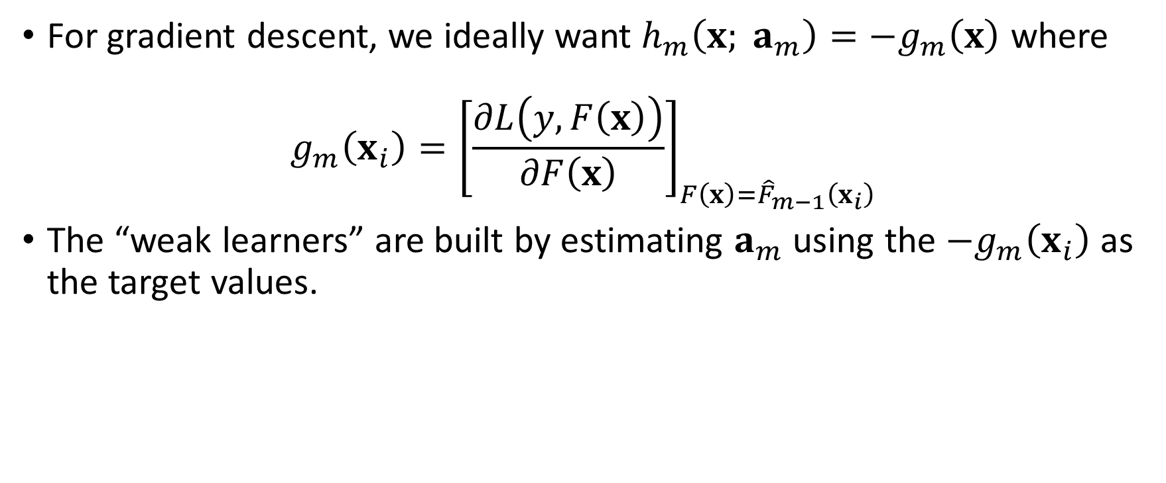
Gradient Boosting (Friedman, 2001)
For gradient descent, we ideally want $h_{m}\left(x; a_{m}\right)=−g_{m}\left(x\right)$ where
$$g_{m}\left(x_{i}\right)={\left[\frac{∂L\left(y,F\left(x\right)\right)}{∂F\left(x\right)}\right]}_{F\left(x\right)={\hat{F}}_{m−1}\left(x_{i}\right)}$$
The “weak learners” are built by estimating $a_{m}$ using the ${−g}_{m}\left(x_{i}\right)$ as the target values.

Slide 19
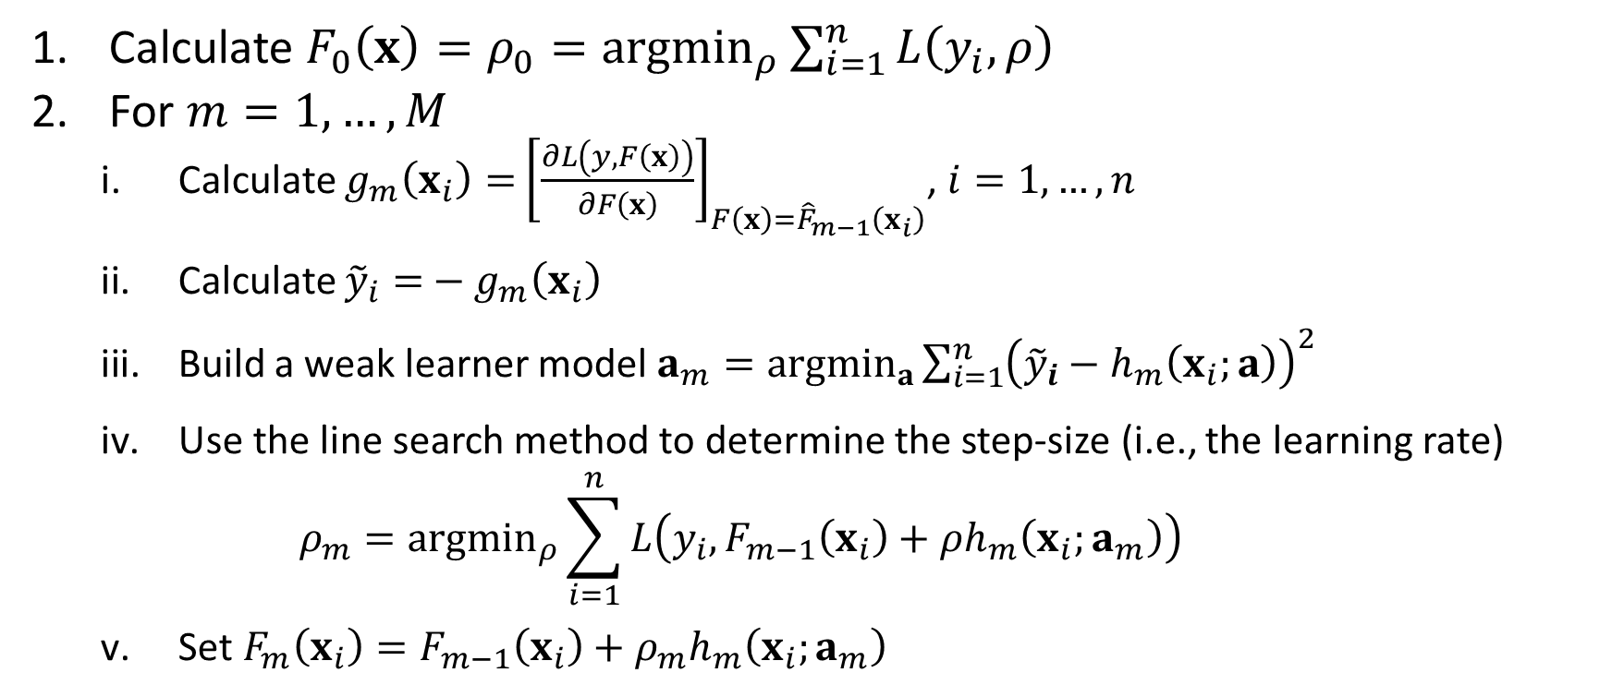
Gradient Boosting Algorithm
Calculate $F_{0}\left(x\right)=ρ_{0}={argmin}_{ρ}\sum_{i=1}^{n}{L\left(y_{i},ρ\right)}$
For $m=1,…,M$
Calculate $g_{m}\left(x_{i}\right)=$ ${\left[\frac{∂L\left(y,F\left(x\right)\right)}{∂F\left(x\right)}\right]}_{F\left(x\right)={\hat{F}}_{m−1}\left(x_{i}\right)}$, $i=1,…,n$
Calculate ${\tilde{y}}_{i}=$ ${− g}_{m}\left(x_{i}\right)$
Build a weak learner model $a_{m}={argmin}_{a}\sum_{i=1}^{n}{{\left({\tilde{y}}_{i}−h_{m}\left(x_{i};a\right)\right)}^{2}}$
Use the line search method to determine the step-size (i.e., the learning rate) $ρ_{m}={argmin}_{ρ}\sum_{i=1}^{n}{L\left(y_{i}, F_{m−1}\left(x_{i}\right)+ρh_{m}\left(x_{i};a_{m}\right)\right)}$
Set $F_{m}\left(x_{i}\right)=F_{m−1}\left(x_{i}\right)+ρ_{m}h_{m}\left(x_{i};a_{m}\right)$

Slide 20
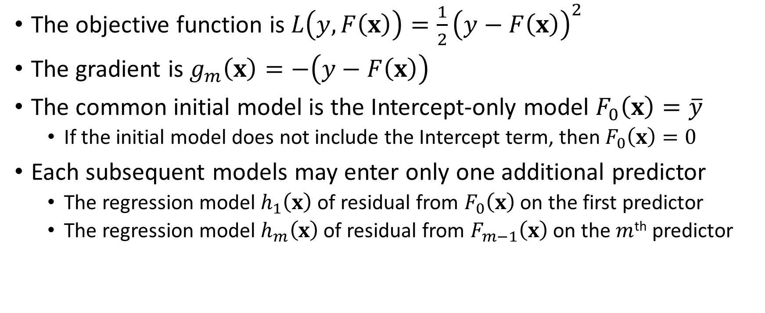
Least Squares Regression
The objective function is $L\left(y,F\left(x\right)\right)=\frac{1}{2}{\left(y−F\left(x\right)\right)}^{2}$
The gradient is $g_{m}\left(x\right)=−\left(y−F\left(x\right)\right)$
The common initial model is the Intercept-only model $F_{0}\left(x\right)=\overline{y}$
If the initial model does not include the Intercept term, then $F_{0}\left(x\right)=0$
Each subsequent models may enter only one additional predictor
The regression model $h_{1}\left(x\right)$of residual from $F_{0}\left(x\right)$ on the first predictor
The regression model $h_{m}\left(x\right)$of residual from $F_{m−1}\left(x\right)$ on the $m$^{th} predictor

Slide 21
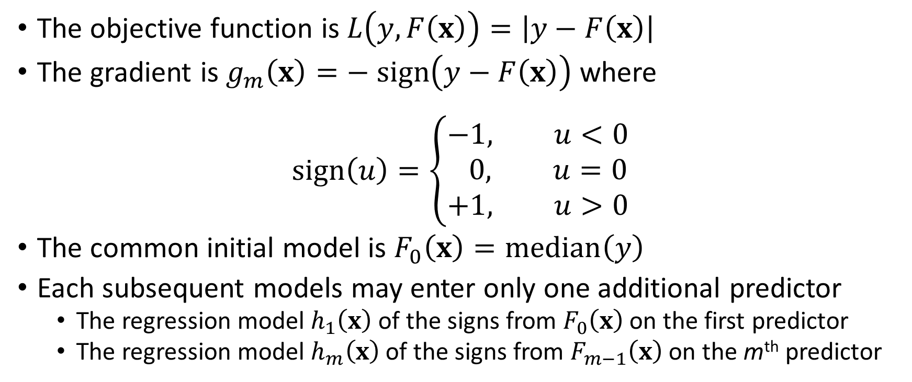
Least Absolute Deviation (LAD) Regression
The objective function is $L\left(y,F\left(x\right)\right)=\left|y−F\left(x\right)\right|$
The gradient is $g_{m}\left(x\right)=− sign\left(y−F\left(x\right)\right)$ where
$$sign\left(u\right)=\left\{\begin{aligned}−&1, u<0 \\ 0, u=0 \\ +1, u>0\end{aligned}\right.$$
The common initial model is $F_{0}\left(x\right)=median\left(y\right)$
Each subsequent models may enter only one additional predictor
The regression model $h_{1}\left(x\right)$of the signs from $F_{0}\left(x\right)$ on the first predictor
The regression model $h_{m}\left(x\right)$of the signs from $F_{m−1}\left(x\right)$ on the m^{th} predictor

Slide 22
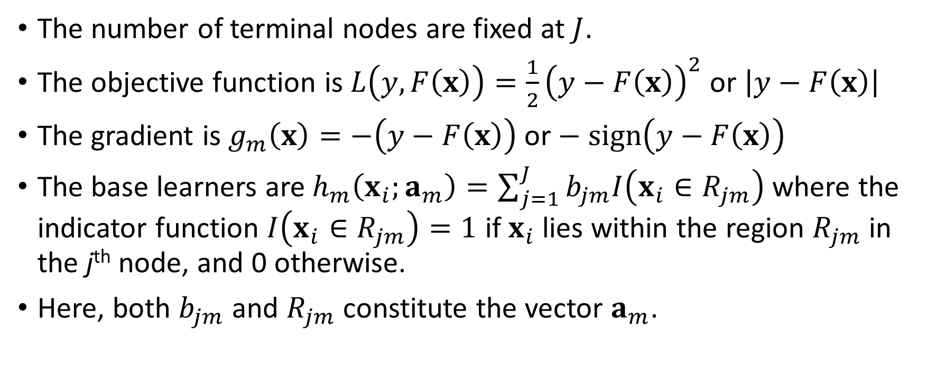
Regression Tree
The number of terminal nodes are fixed at $J$.
The objective function is $L\left(y,F\left(x\right)\right)=\frac{1}{2}{\left(y−F\left(x\right)\right)}^{2}$ or $\left|y−F\left(x\right)\right|$
The gradient is $g_{m}\left(x\right)=−\left(y−F\left(x\right)\right)$or $− sign\left(y−F\left(x\right)\right)$
The base learners are $h_{m}\left(x_{i};a_{m}\right)=\sum_{j=1}^{J}{b_{jm}I\left(x_{i}∈R_{jm}\right)}$ where the indicator function $I\left(x_{i}∈R_{jm}\right)=1$ if $x_{i}$ lies within the region $R_{jm}$ in the j^{th} node, and 0 otherwise.
Here, both $b_{jm}$ and $R_{jm}$ constitute the vector $a_{m}$.

Slide 23
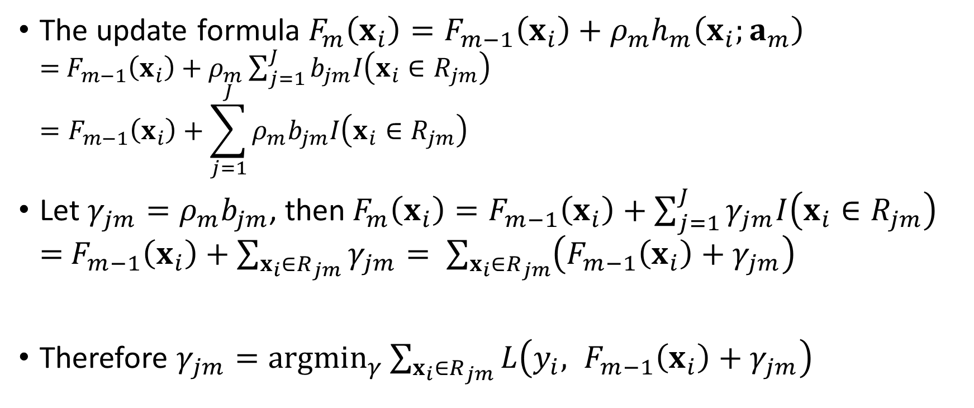
Regression Tree
The update formula $F_{m}\left(x_{i}\right)=F_{m−1}\left(x_{i}\right)+ρ_{m}h_{m}\left(x_{i};a_{m}\right)$ $=$ $F_{m−1}\left(x_{i}\right)+ρ_{m}\sum_{j=1}^{J}{b_{jm}I\left(x_{i}∈R_{jm}\right)}$ $=F_{m−1}\left(x_{i}\right)+\sum_{j=1}^{J}{ρ_{m}b_{jm}I\left(x_{i}∈R_{jm}\right)}$
Let $γ_{jm}=ρ_{m}b_{jm}$, then$F_{m}\left(x_{i}\right)=F_{m−1}\left(x_{i}\right)+\sum_{j=1}^{J}{γ_{jm}I\left(x_{i}∈R_{jm}\right)}$ $=$ $F_{m−1}\left(x_{i}\right)+\sum_{x_{i}∈R_{jm}}{γ_{jm}}= \sum_{x_{i}∈R_{jm}}{\left(F_{m−1}\left(x_{i}\right)+γ_{jm}\right)}$
Therefore $γ_{jm}={argmin}_{γ}\sum_{x_{i}∈R_{jm}}{L\left({y_{i}, F}_{m−1}\left(x_{i}\right)+γ_{jm}\right)}$

Slide 24

Regression Tree
If $L$ is the least squares function, then $γ_{jm}$ is the mean of the ${\tilde{y}}_{i}$ in the region $R_{jm}$ or the $j$^{th} terminal node in the $m$^{th} iteration.
If $L$ is the least absolute deviation function, then $γ_{jm}$ is the median of the ${\tilde{y}}_{i}$ in the region $R_{jm}$ or the $j$^{th} terminal node in the $m$^{th} iteration.

Slide 25
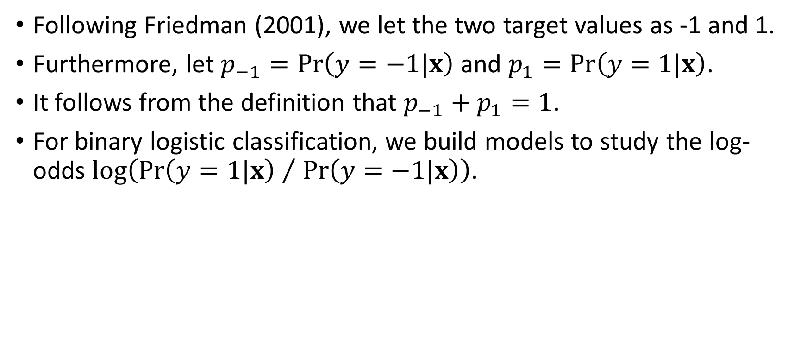
Binary Logistic Classification
Following Friedman (2001), we let the two target values as -1 and 1.
Furthermore, let $p_{−1}=Pr\left(y=−1|x\right)$ and $p_{1}=Pr\left(y=1|x\right)$.
It follows from the definition that $p_{−1}+p_{1}=1$.
For binary logistic classification, we build models to study the log-odds $log\left({Pr\left(y=1|x\right) }/{ Pr\left(y=−1|x\right)}\right)$.

Slide 26
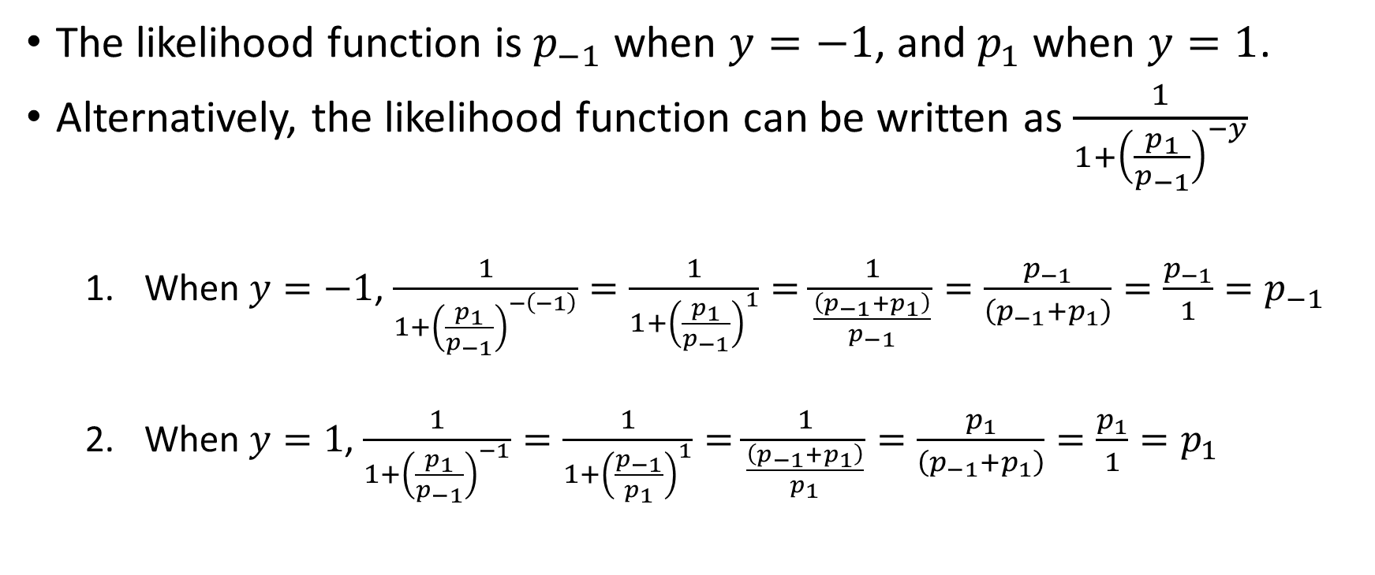
Binary Logistic Classification
The likelihood function is $p_{−1}$ when $y=−1$, and $p_{1}$ when $y=1$.
Alternatively, the likelihood function can be written as $\frac{1}{1+{\left(\frac{p_{1}}{p_{−1}}\right)}^{−y}}$
When $y=−1$, $\frac{1}{1+{\left(\frac{p_{1}}{p_{−1}}\right)}^{−\left(−1\right)}}=\frac{1}{1+{\left(\frac{p_{1}}{p_{−1}}\right)}^{1}}=\frac{1}{\frac{\left(p_{−1}+p_{1}\right)}{p_{−1}}}=\frac{p_{−1}}{\left(p_{−1}+p_{1}\right)}=\frac{p_{−1}}{1}=p_{−1}$
When $y=1$, $\frac{1}{1+{\left(\frac{p_{1}}{p_{−1}}\right)}^{−1}}=\frac{1}{1+{\left(\frac{p_{−1}}{p_{1}}\right)}^{1}}=\frac{1}{\frac{\left(p_{−1}+p_{1}\right)}{p_{1}}}=\frac{p_{1}}{\left(p_{−1}+p_{1}\right)}=\frac{p_{1}}{1}=p_{1}$

Slide 27
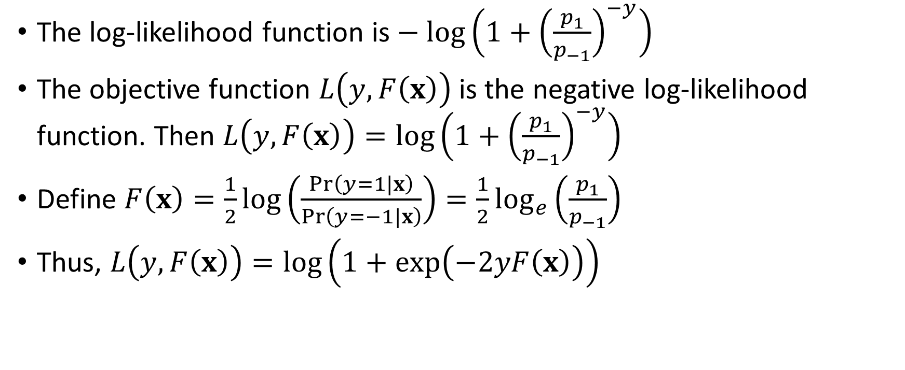
Binary Logistic Classification
The log-likelihood function is $− log\left(1+{\left(\frac{p_{1}}{p_{−1}}\right)}^{−y}\right)$
The objective function $L\left(y,F\left(x\right)\right)$ is the negative log-likelihood function. Then $L\left(y,F\left(x\right)\right)=log\left(1+{\left(\frac{p_{1}}{p_{−1}}\right)}^{−y}\right)$
Define $F\left(x\right)=\frac{1}{2}log\left(\frac{Pr\left(y=1|x\right)}{Pr\left(y=−1|x\right)}\right)=\frac{1}{2}\log_{e}\left(\frac{p_{1}}{p_{−1}}\right)$
Thus, $L\left(y,F\left(x\right)\right)=log\left(1+exp\left(−2yF\left(x\right)\right)\right)$

Slide 28
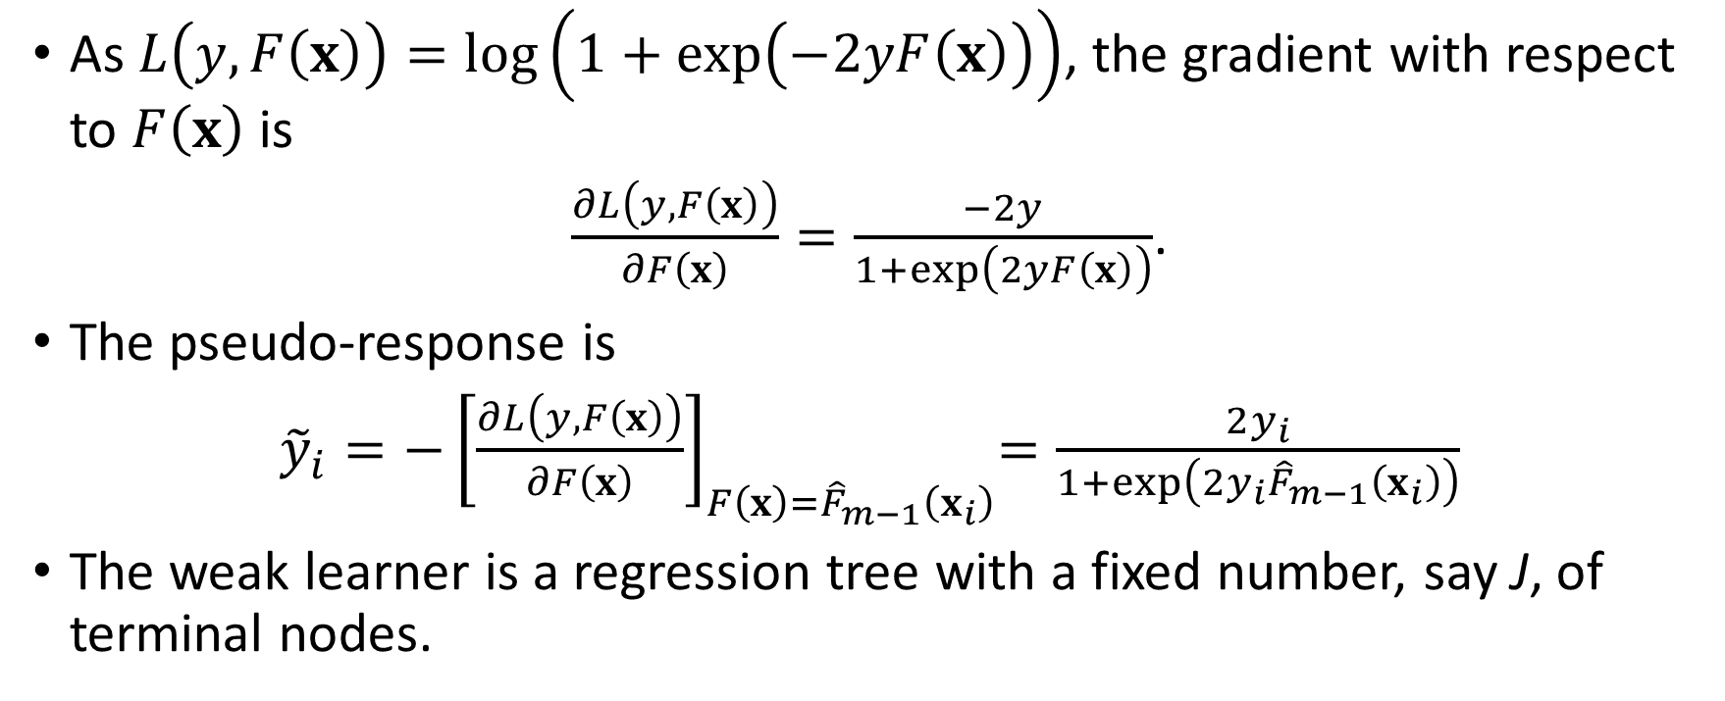
Binary Logistic Classification
As $L\left(y,F\left(x\right)\right)=log\left(1+exp\left(−2yF\left(x\right)\right)\right)$, the gradient with respect to $F\left(x\right)$ is
$\frac{∂L\left(y,F\left(x\right)\right)}{∂F\left(x\right)}=\frac{−2y}{1+exp\left(2yF\left(x\right)\right)}$.
The pseudo-response is
${\tilde{y}}_{i}={−\left[\frac{∂L\left(y,F\left(x\right)\right)}{∂F\left(x\right)}\right]}_{F\left(x\right)={\hat{F}}_{m−1}\left(x_{i}\right)}=\frac{2y_{i}}{1+exp\left(2y_{i}{\hat{F}}_{m−1}\left(x_{i}\right)\right)}$
The weak learner is a regression tree with a fixed number, say J, of terminal nodes.

Slide 29
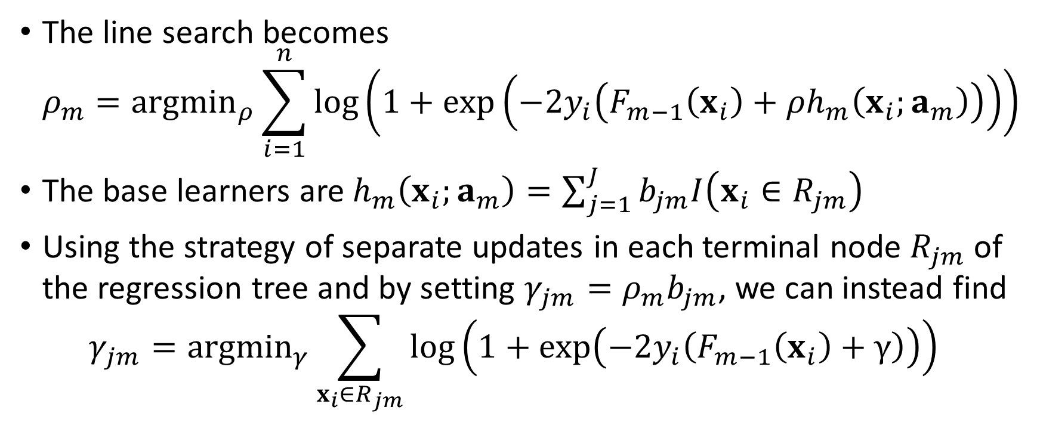
Binary Logistic Classification
The line search becomes $ρ_{m}={argmin}_{ρ}\sum_{i=1}^{n}{log\left(1+exp\left(−2y_{i}\left(F_{m−1}\left(x_{i}\right)+ρh_{m}\left(x_{i};a_{m}\right)\right)\right)\right)}$
The base learners are $h_{m}\left(x_{i};a_{m}\right)=\sum_{j=1}^{J}{b_{jm}I\left(x_{i}∈R_{jm}\right)}$
Using the strategy of separate updates in each terminal node $R_{jm}$ of the regression tree and by setting $γ_{jm}=ρ_{m}b_{jm}$, we can instead find $γ_{jm}={argmin}_{γ}\sum_{x_{i}∈R_{jm}}{log\left(1+exp\left(−2y_{i}\left(F_{m−1}\left(x_{i}\right)+γ\right)\right)\right)}$

Slide 30
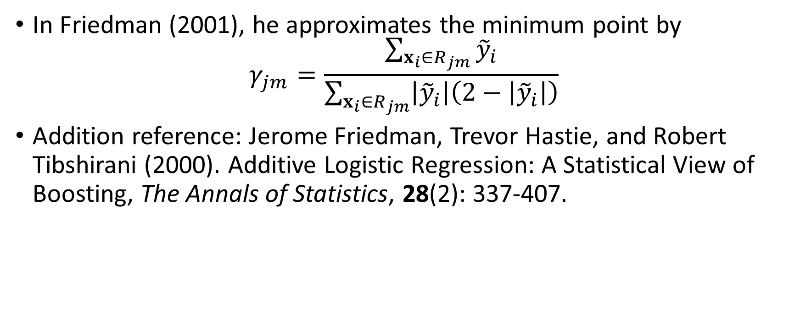
Binary Logistic Classification
In Friedman (2001), he approximates the minimum point by $γ_{jm}=\frac{\sum_{x_{i}∈R_{jm}}{{\tilde{y}}_{i}}}{\sum_{x_{i}∈R_{jm}}{\left|{\tilde{y}}_{i}\right|\left(2−\left|{\tilde{y}}_{i}\right|\right)}}$
Addition reference: Jerome Friedman, Trevor Hastie, and Robert Tibshirani (2000). Additive Logistic Regression: A Statistical View of Boosting, The Annals of Statistics, 28(2): 337-407.

Slide 31
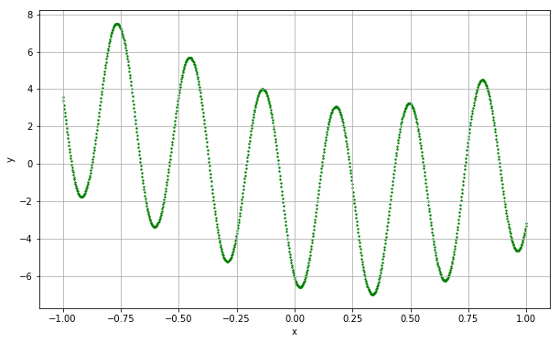
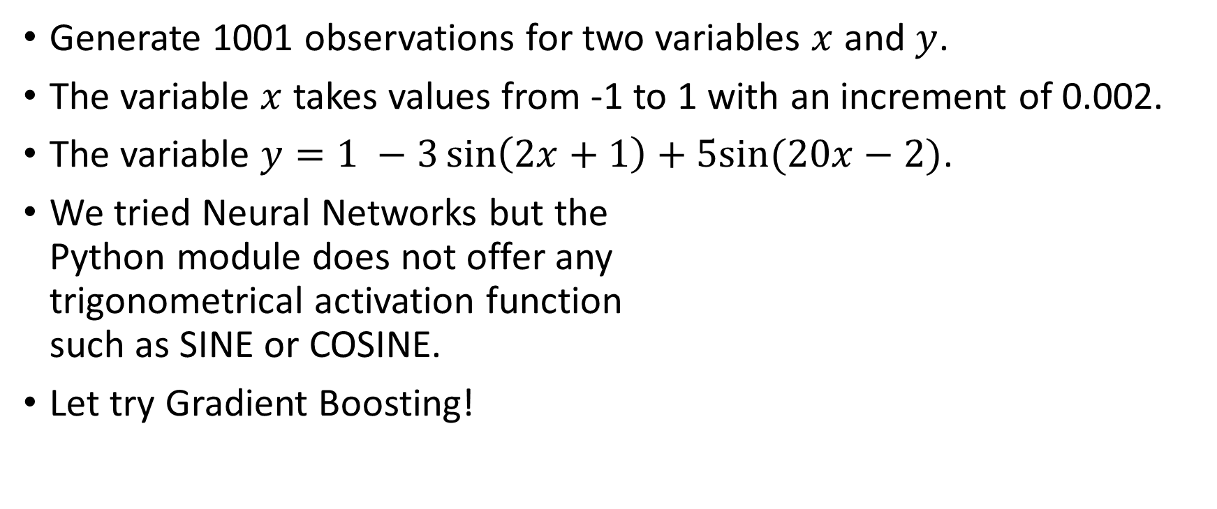
Composite Sine Data Example
Generate 1001 observations for two variables $x$ and $y$.
The variable $x$ takes values from -1 to 1 with an increment of 0.002.
The variable $y=1 −3\sin\left(2x+1\right)+5sin⁡(20x−2)$.
We tried Neural Networks but the Python module does not offer any trigonometrical activation function such as SINE or COSINE.
Let try Gradient Boosting!

Slide 32
Composite Sine Data Example
Gradient Boosting Regressor specifications
The loss function (L) is the Least Squares
The number of boosting step (M) is 1, 5, 10, 20, 40, 80, 100, 500, and 1000
The tree splitting criterion is the Mean Squared Error
The maximum number of tree terminal nodes is 14
Use the R-squared statistic to measure the goodness-of-fit between the observed and the predicted target values.
Week 15 Gradient Boosting Sine Curve.py

Slide 33
Composite Sine Data Example
Number of Boosting Steps (M) | R-Square Statistic
1 | 0.11354091
5 | 0.41408476
10 | 0.64476808
20 | 0.81391791
40 | 0.95127976
60 | 0.98595782
80 | 0.99553327
100 | 0.99833336
500 | 0.99995400
1000 | 0.99999360
Linear Regression Reference:
R-Square = 0.09396008
Intercept = -0.35467673
Slope = -2.00820904

Slide 34
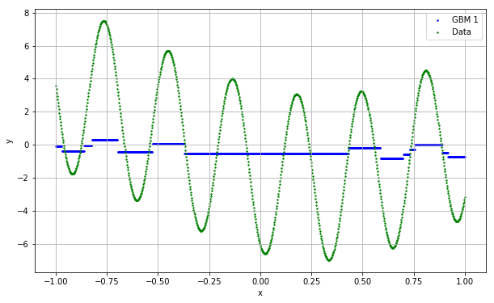
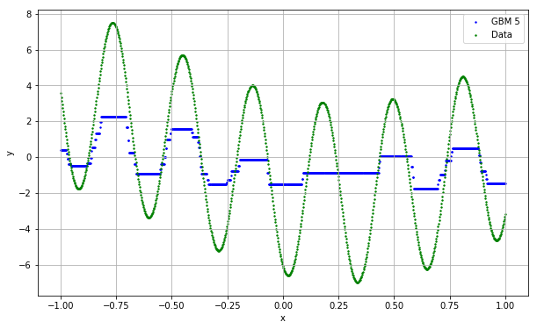
Composite Sine Data Example
Already picked up some cyclic patterns!

Slide 35
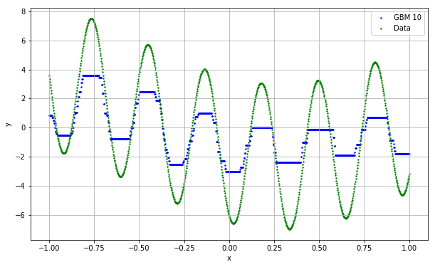
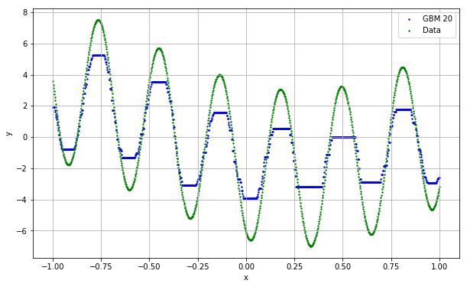
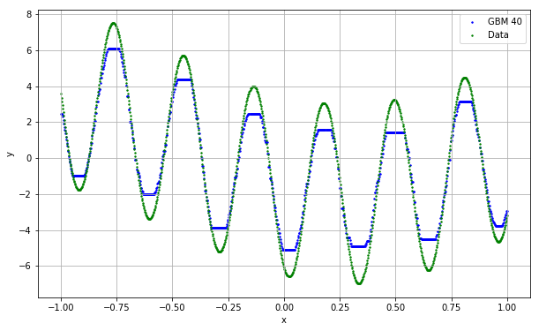
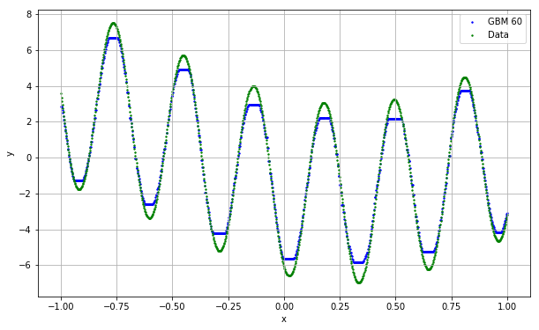
Composite Sine Data Example

Slide 36
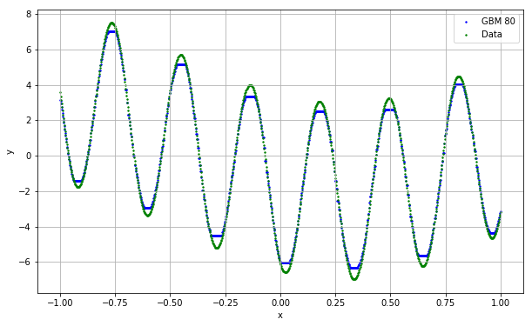
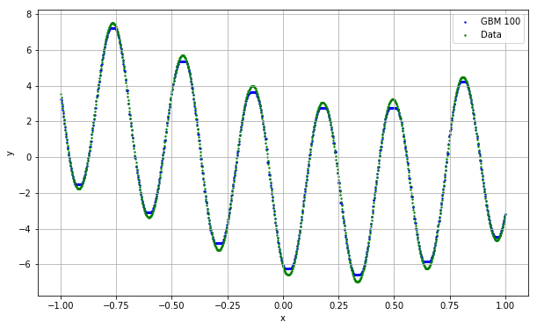
Composite Sine Data Example

Slide 37
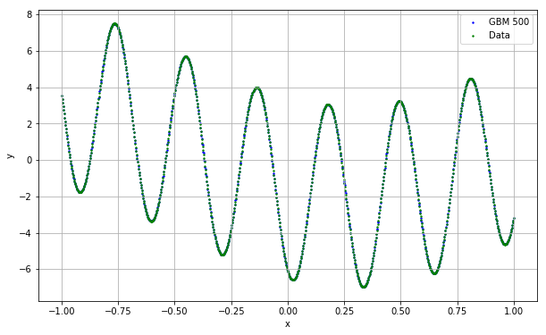
Composite Sine Data Example
Iter Train Loss Remaining Time
1 12.7081 0.25s
2 11.4178 0.37s
3 10.2209 0.33s
4 9.2899 0.31s
5 8.3995 0.35s
6 7.7258 0.35s
7 6.8859 0.33s
8 6.1916 0.32s
9 5.6236 0.31s
10 5.0925 0.33s
20 2.6676 0.24s
30 1.2962 0.21s
40 0.6984 0.20s
50 0.3625 0.19s
60 0.2013 0.17s
70 0.1150 0.17s
80 0.0640 0.16s
90 0.0397 0.16s
100 0.0239 0.15s
200 0.0033 0.10s
300 0.0017 0.07s
400 0.0010 0.03s
500 0.0007 0.00s

Slide 38
Wine Quality Classification Example
quality_grp | Frequency | Percent
0 | 5,220 | 80.3%
1 | 1,277 | 19.7%
There are 6,497 observations.
The binary target variable is quality_grp
Consider these seven interval predictors:
fixed_acidity
citric_acid
residual_sugar
free_sulfur_dioxide
total_sulfur_dioxide
pH
sulphates
We intentionally hold back the four most predictive variables: volatile_acidity, chlorides, density, and alcohol
Week 15 Gradient Boosting Wine.py

Slide 39
Wine Quality Classification Example
A Binary Logistic model
The Confusion Matrix is
The accuracy rate is 80.28%
Model | Parameter Estimate
const | 0.480926
fixed_acidity | -0.253305
citric_acid | 1.970866
residual_sugar | -0.030953
free_sulfur_dioxide | 0.015142
total_sulfur_dioxide | -0.007365
pH | -0.139795
sulphates | 0.503669
 | Predicted Class
quality_grp | 0 | 1
0 | 5,214 | 6
1 | 1,275 | 2
Week 15 Gradient Boosting Wine.py

Slide 40
Wine Quality Classification Example
Gradient Boosting Regressor specifications
The loss function (L) is the Deviance (i.e., the log-likelihood)
The number of boosting step (M) is 1, 5, 10, 20, 40, 80, 100, 500, and 1000
The tree splitting criterion is the Mean Squared Error
The maximum number of tree terminal nodes is 10
Use the Accuracy statistic to measure the goodness-of-fit between the observed and the predicted target values.
Week 15 Gradient Boosting Sine Curve.py

Slide 41
Wine Quality Classification Example
Number of Boosting Steps (M) | Accuracy Statistic
1 | 80.34%
5 | 80.34%
10 | 80.54%
20 | 80.85%
40 | 81.78%
60 | 83.02%
80 | 83.68%
100 | 84.41%
500 | 92.27%
1000 | 96.95%
Logistic Regression Reference:
Accuracy = 80.28%

Slide 42
Wine Quality Classification Confusion Matrix
Logistic Regression | Predicted Class
quality_grp | 0 | 1
0 | 5,214 | 6
1 | 1,275 | 2
GBM 1 | Predicted Class
quality_grp | 0 | 1
0 | 5,220 | 0
1 | 1,277 | 0
GBM 5 | Predicted Class
quality_grp | 0 | 1
0 | 5,220 | 0
1 | 1,277 | 0
GBM 10 | Predicted Class
quality_grp | 0 | 1
0 | 5,220 | 0
1 | 1,264 | 13
GBM 20 | Predicted Class
quality_grp | 0 | 1
0 | 5,220 | 0
1 | 1,244 | 33
GBM 40 | Predicted Class
quality_grp | 0 | 1
0 | 5,200 | 20
1 | 1,164 | 113
GBM 60 | Predicted Class
quality_grp | 0 | 1
0 | 5,275 | 45
1 | 1,058 | 219
GBM 80 | Predicted Class
quality_grp | 0 | 1
0 | 5,161 | 59
1 | 1,001 | 276
GBM 100 | Predicted Class
quality_grp | 0 | 1
0 | 5,148 | 72
1 | 941 | 336

Slide 43
Wine Quality Classification Confusion Matrix
GBM 500 | Predicted Class
quality_grp | 0 | 1
0 | 5,161 | 59
1 | 443 | 834
More boosting steps will increase the accuracy rate
Can we achieve a 100% accuracy rate? Let’s try 2,500 boosting steps.
GBM 1000 | Predicted Class
quality_grp | 0 | 1
0 | 5,200 | 20
1 | 178 | 1,099
GBM 2500 | Predicted Class
quality_grp | 0 | 1
0 | 5,219 | 1
1 | 1 | 1,276

Slide 44
Gradient Boosting: Pros
The gradient boosting algorithm is really easy to use, and it runs fast.
The algorithm works, in theory, with any base learners
Avoids the often confusing choices of convergence criteria (because, it basically have none, except the number of boosting steps)
It does not need to know the original learning algorithm (e.g., neural network or support vector machine)
The decision tree base learner inherits the favorable merits of tree
Robustness against outliers and extreme values
Unnecessary to transform input variables
A built-in mechanism to select input variables
Ability to handle missing values in input variables

Slide 45
Gradient Boosting: Cons
The gradient boosting algorithm is difficult to deploy.
Because it actually produced many base learners like most Bagging and the AdaBoost algorithm
Special attention is needed to ensure all base learners return valid scores
The decision tree base learner inherits the unfavorable characteristics of the tree algorithm
Inaccuracy due to not enough terminal nodes for smaller trees
Instability due to overfitting for larger trees
Often confusing choices of specifying a tree, e.g., maximum number of nodes, maximum number of depths, minimum observations in a node, etc.

Slide 46
XGBoost: eXtreme Gradient Boosting
According to https://github.com/dmlc/xgboost
XGBoost is an optimized distributed gradient boosting library designed to be highly efficient, flexible and portable.
XGBoost implements machine learning algorithms under the Gradient Boosting framework.
XGBoost provides a parallel tree boosting that solve many data science problems in a fast and accurate way.
Chen, Tianqi and Guestrin, Carlos (2016). XGBoost: A Scalable Tree Boosting System, Proceedings of the 22nd ACM SIGKDD Conference on Knowledge Discovery and Data Mining, 2016, San Francisco. pp. 785-794 https://dl.acm.org/citation.cfm?id=2939785

Slide 47
Composite Sine Data Example
Extreme Gradient Boosting Regressor specifications
The number of boosting step (M) is 1, 5, 10, 20, 40, 80, 100, 500, and 1000
The tree maximum depth is 3
The random state value is 60616
Use the R-squared statistic to measure the goodness-of-fit between the observed and the predicted target values.
Week 15 XGBoosting Sine Curve.py

Slide 48
Composite Sine Data Example
Number of XGBoosting Steps | R-Square Statistic
1 | 0.04252874
5 | 0.29202585
10 | 0.49145709
20 | 0.67836862
40 | 0.86551065
60 | 0.93214265
80 | 0.96489772
100 | 0.98313266
500 | 0.99977819
1000 | 0.99990370
Linear Regression Reference:
R-Square = 0.09396008
Intercept = -0.35467673
Slope = -2.00820904

Slide 49
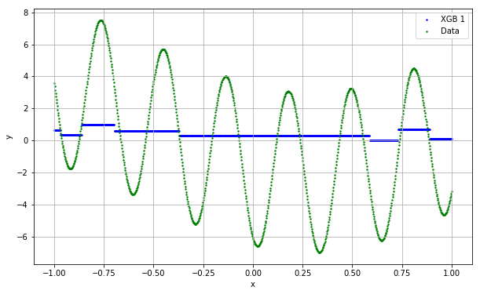
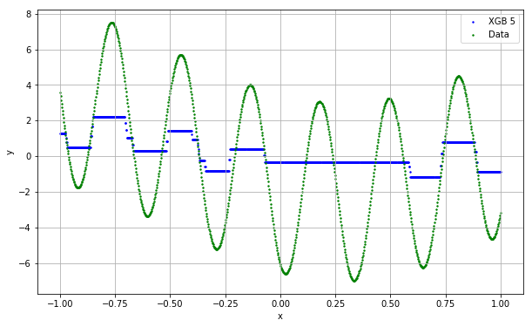
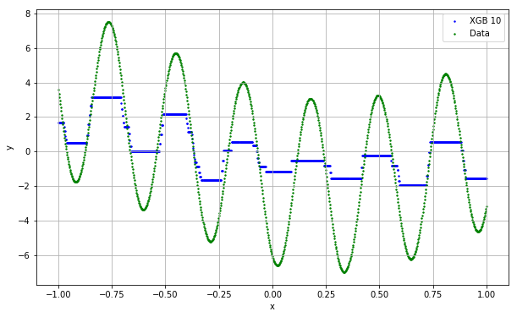
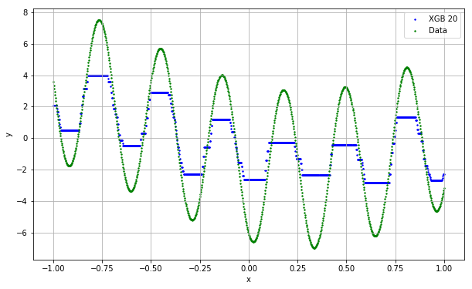
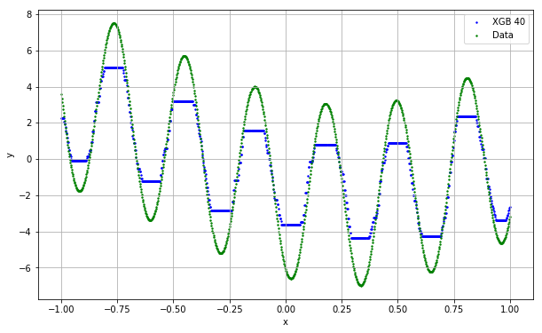
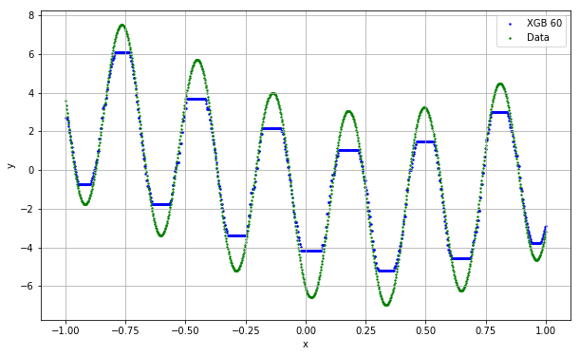
Composite Sine Data Example

Slide 50
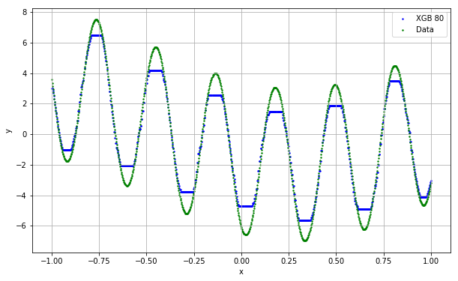
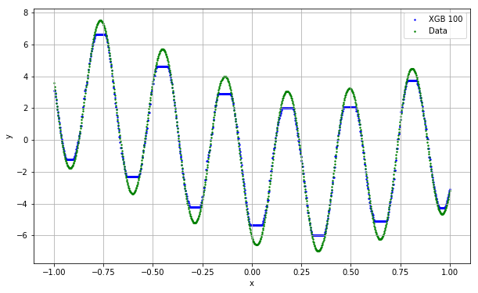
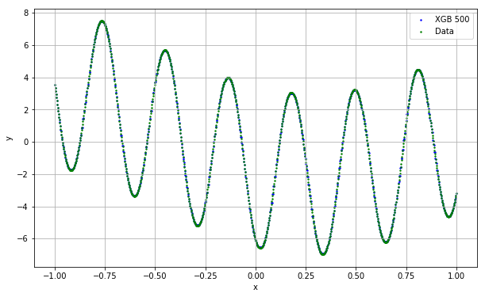
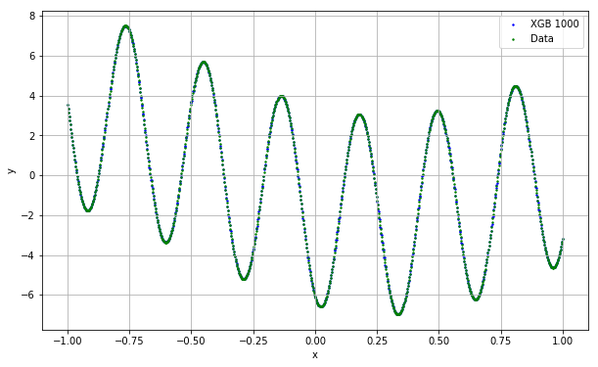
Composite Sine Data Example

Slide 51
Model Stacking: Overview
Model stacking is a meta-ensemble method. It contains two levels.
In the first level, several models are built by using different learning algorithms (e.g., logistic regression, naïve Bayes, neural networks, and support vector machines). Each model generates its own predictions (whether predicted probabilities or predicted class)
In the second level, the compatible predictions are combined optimally by yet another model.

Slide 52
Model Stacking: Second Level
Interval Target Variable
The predicted values from the first level models are inputs to a regression model.
The original target values are the dependent values of that regression.
Categorial Target Variable
The predicted values from the first level models are inputs to a logistic regression model.
The original target categories are the dependent values of that logistic regression.

Slide 53
Model Stacking: References
Joseph Sill, Gabor Takacs, Lester Mackey, and David Lin (2009). https://www.researchgate.net/publication/45882061_Feature-Weighted_Linear_Stacking
Funda Gunes, Russ Wolfinger, and Pei-Yi Tan (2017). Stacked Ensemble Models for Improved Prediction Accuracy, Proceedings of the SAS Global Forum 2017, Orlando, Florida. https://support.sas.com/resources/papers/proceedings17/SAS0437-2017.pdf
The Python mlxtend module. (We used mlxtend for Association Rule) http://rasbt.github.io/mlxtend/user_guide/classifier/StackingClassifier/

Slide 54
Special Announcements
I am going to attend the SAS® Global Forum 2019 from April 28 to May 1 at Dallas, Texas
You can watch selected live sessions at https://www.sas.com/en_us/events/sas-global-forum/virtual.html
I will present a paper titled Monitoring the Relevance of Predictors for a Model Over Time (SAS3448-2019) on May 1.
No Instructor Office Hour on next Monday, April 29, 2019
No Class on next Wednesday, May 1, 2019

Slide 55
Final Exam
The Final Exam has 20 short questions.
Each question carries 5 points.
The exam will be available online starting 12:01 AM on May 2, 2019.
You will complete the exam online within 300 minutes.
You can choose when to start the exam but you must complete the exam in a single attempt.
You can submit your answers only once.
Deadline to submit your answers is 11:59 PM on May 8, 2019
Last Instructor Office Hour 4 – 6 PM on May 6, 2019.

Slide 56
Thank You for Attending the Machine Learning Class!
Contact Information mlam5@iit.edu ming-long.lam@sas.com

